Slide 1
So, now you have a sequence Where do we publish them?
DATABASES

Slide 2
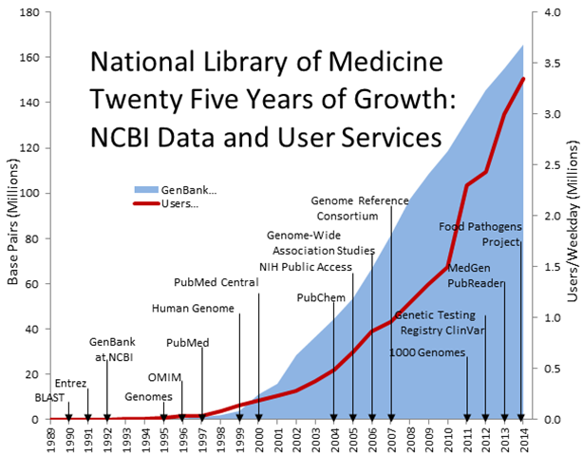
Rapid growth of sequence databases
Notes:
If interested in the National Library of Medicine please see your other handout for an explanation of the points on this graph.

Slide 3







Slide 4
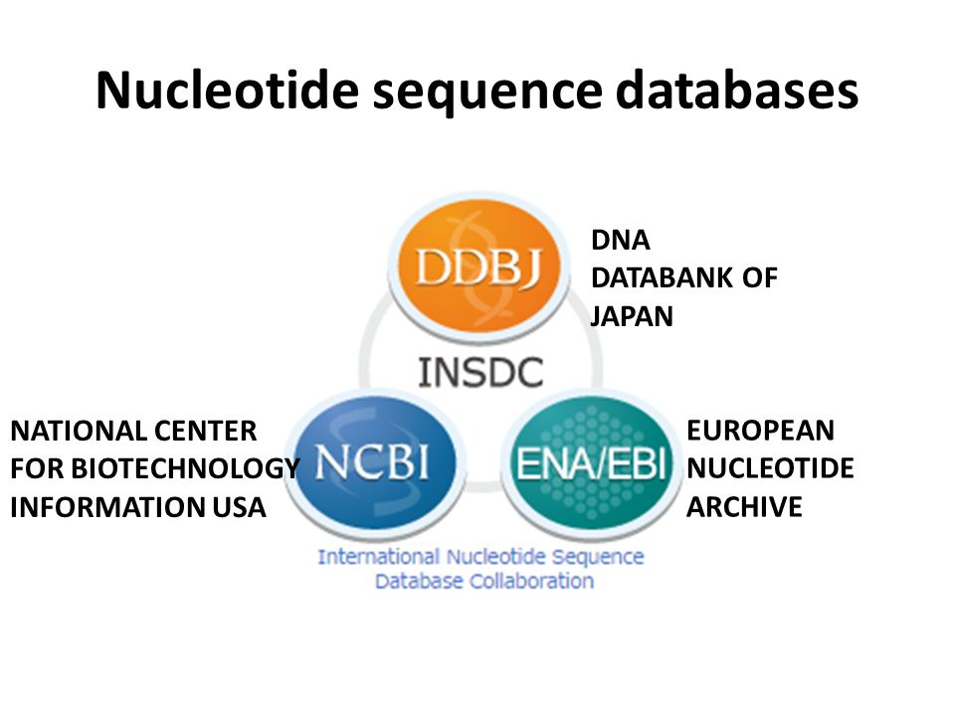

Slide 5
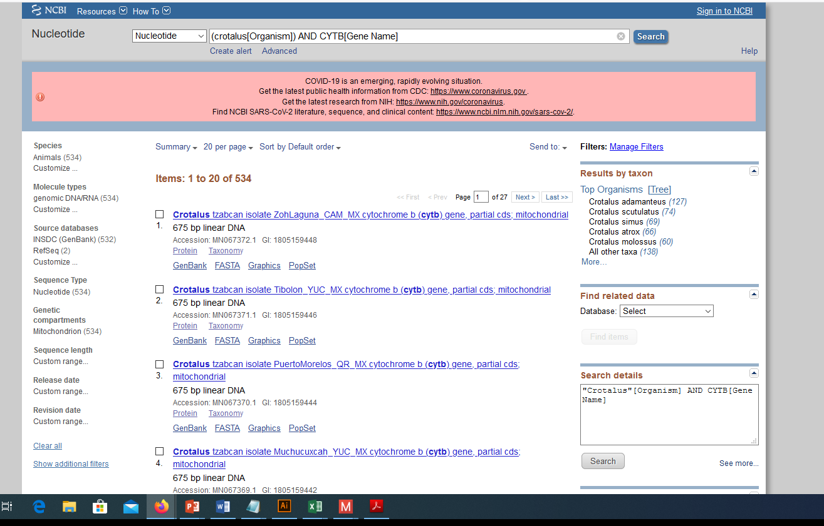
Search for Sequence information by gene and/or Organism

Slide 6

Compare Sequences to each other or across all the data stored in GenBank

Slide 7
Let’s explore GenBank

